Slide 1
Accessible Design with Adobe Express
Ash Mayes

Slide 2
Acknowledgements and
Further Reference
This presentation is guided by Web AIM’s suggestions on digital accessibility, which are informed by the Americans with Disabilities Act (ADA) and the Web Content Accessibility Guidelines (WCAG).
Digital accessibility principles are of course useful for folks with disabilities, but these principles are useful for folks of all abilities.
Accessibility is an ever-evolving project, but implementing as many measures as possible at every opportunity is a good place to start.
This presentation will cover accessibility measures specifically in Adobe Express, but these guiding principles can be applied to all document design.

Slide 3
Table of Contents
Adobe interface (Slides 4-6)
Fonts (Slides 7-8)
Color (Slides 9-13)
Editing the document (Slides 14-15)
Photos and shapes (Slides 16-18)
The completed infographic (Slide 19)

Slide 4
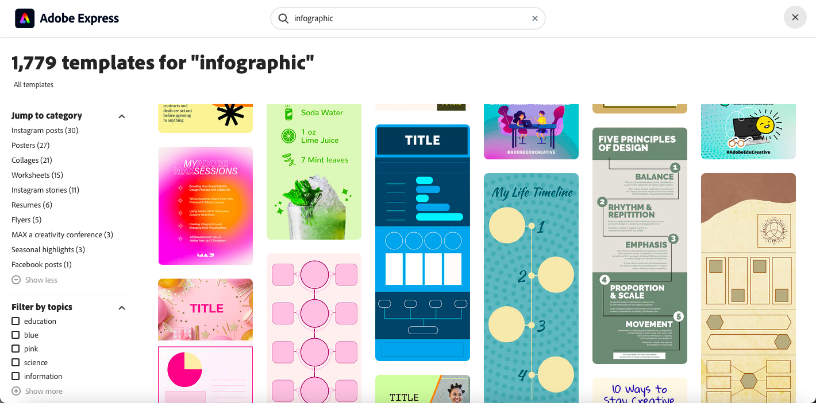
Templates
To begin, search for the sort of document you would like to create. For this presentation, I will be creating an infographic.
Choose a template based on how you plan to organize your document.

Slide 5
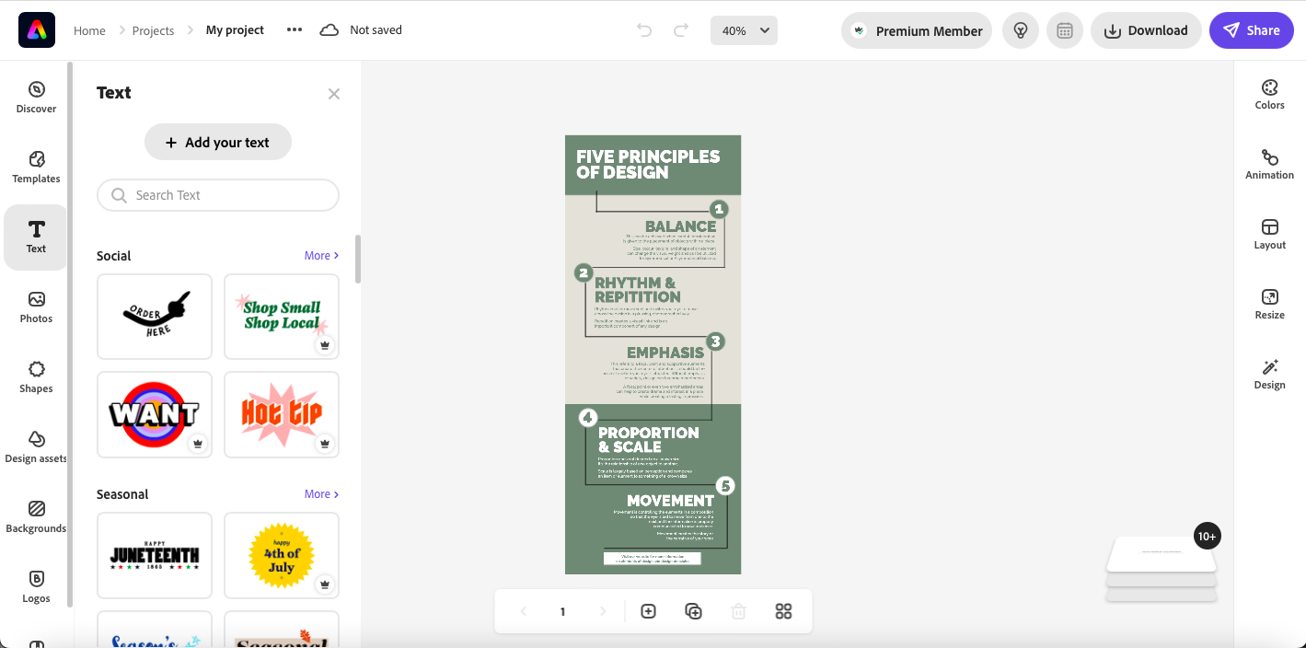
Starting a project
After selecting a template, you will open the design interface.

Slide 6
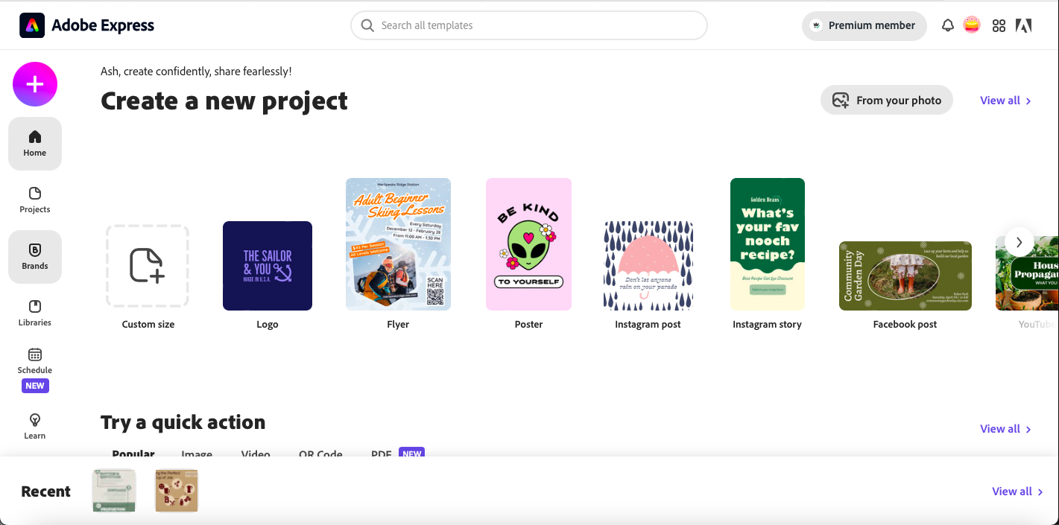
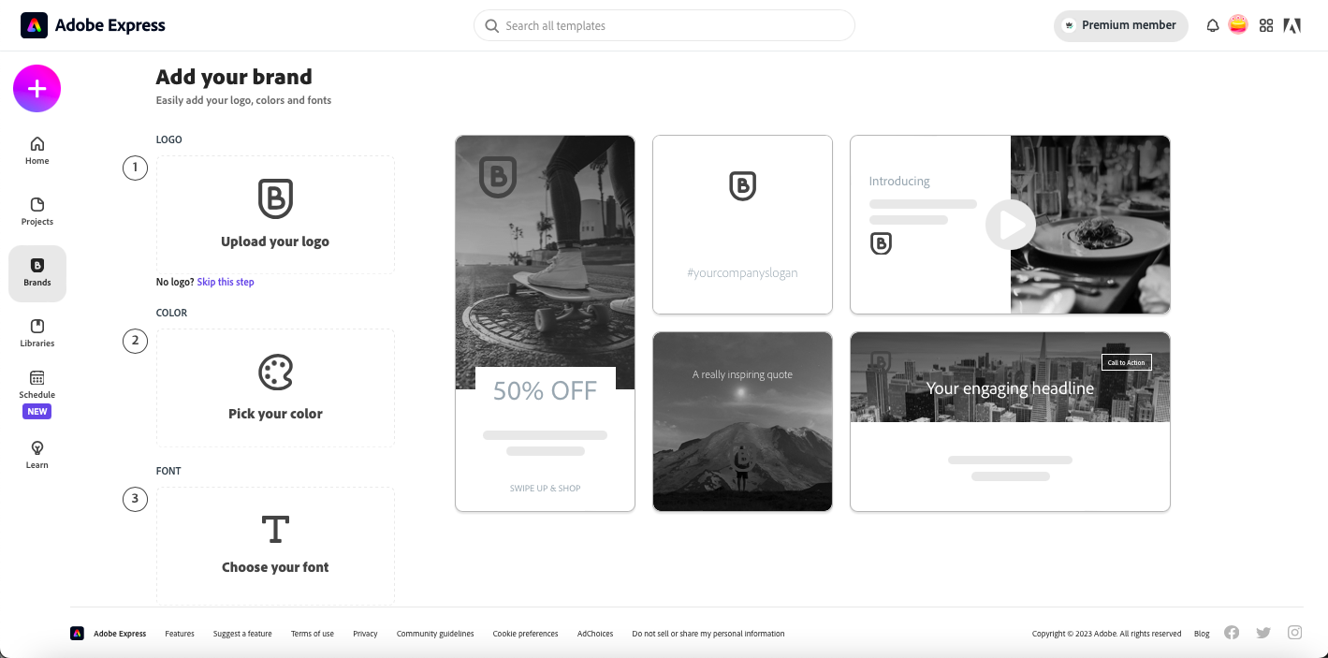
Brands
In order to create a saved color palette and logo (if you so choose), you will need to create a brand.
From the start page of Adobe Express, select Brands from the left-hand menu.
On the Brands page, upload your logo if you have one. Otherwise, select the skip this step option.

Slide 7
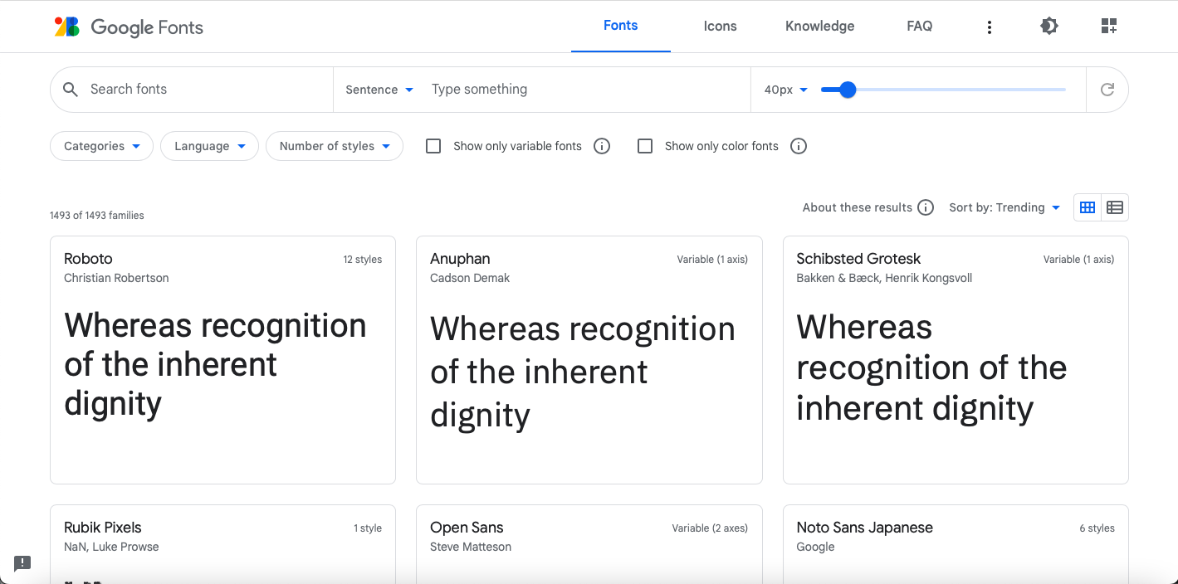
Fonts
When selecting a font, choose fonts that are and have:
Simple
Familiar
Easily-parsed
  Easily distinguishable characters from other characters
  Easily identifiable characters
Appropriately spaced
Appropriately sized
High contrast with the background
You can download font files to upload to Adobe Express on Google Fonts.

Slide 8
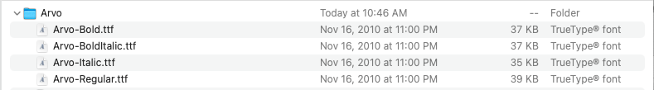
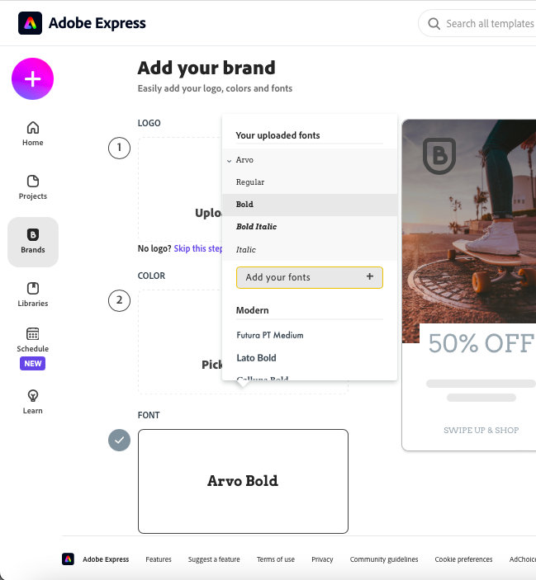
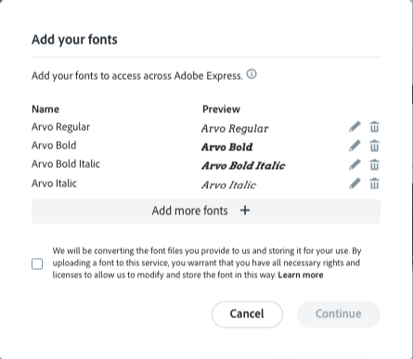
Fonts continued
Font files include the ending .ttf
Upload your choice of font files to Adobe Express for use.
Make sure that the fonts you choose are free for use.
Add your fonts to your brand in order to use them when designing your document.

Slide 9
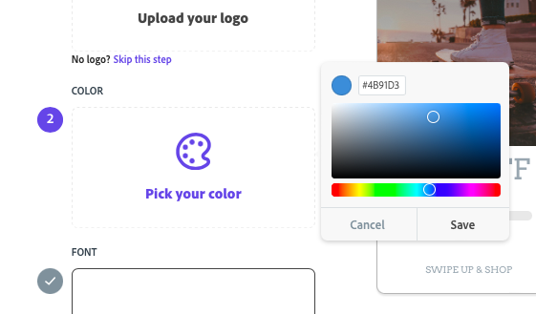
Color
When selecting color, besides pursuing simply aesthetically pleasing palettes, contrast is of utmost importance.
The Brand feature on Adobe Express allows for the creation of a custom color palette.

Slide 10
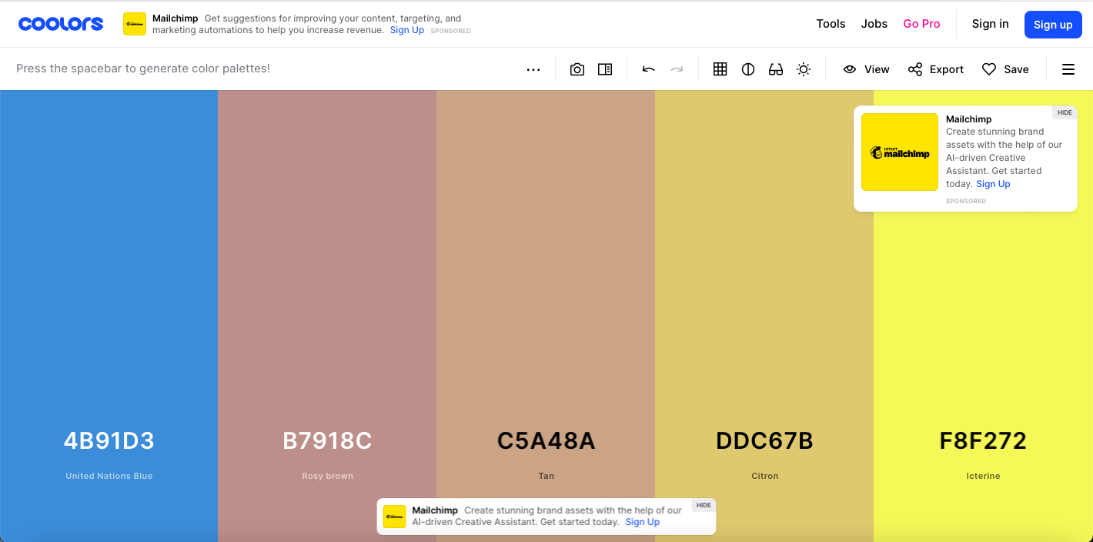
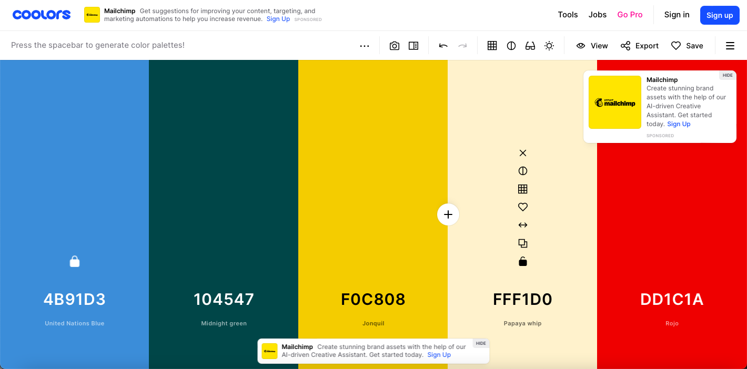
Color continued (1)
Coolors is a color palette generator that can assist in the creation of high-contrast color palettes.
The lock icon allows the use to keep that color and randomly generate the rest.
Record the hex codes to upload to Adobe Express.

Slide 11
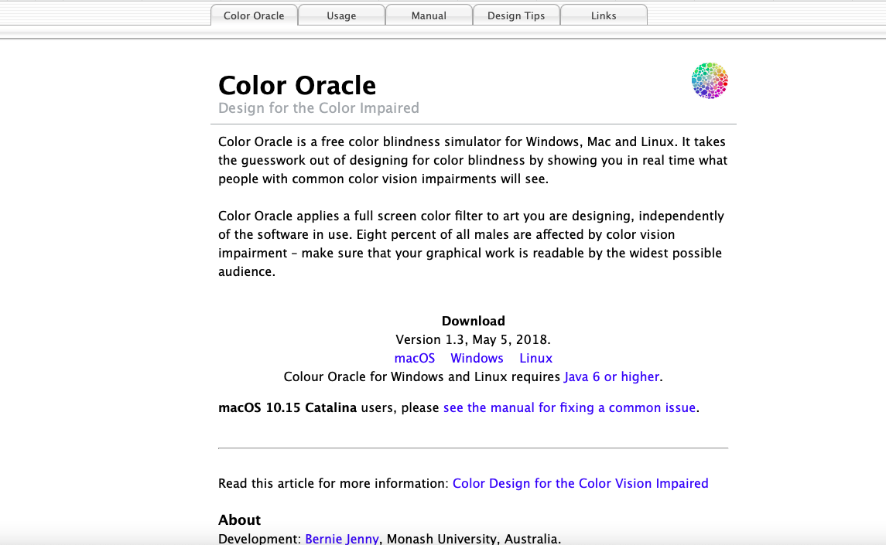
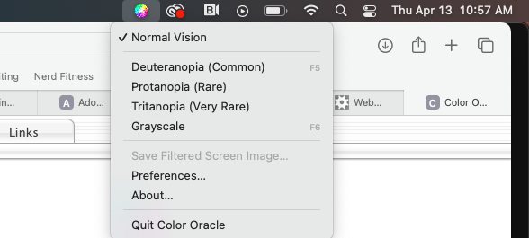
Color continued (2)
Color Oracle is a free color blindness simulator that can help in the design process to check visibility and contrast.
For macOS, the Color Oracle menu will be at the right-hand top menu on your screen.
Color blindness view options include, in order of most common to least common: deuteranopia, protanopia, tritanopia, and grayscale.

Slide 12
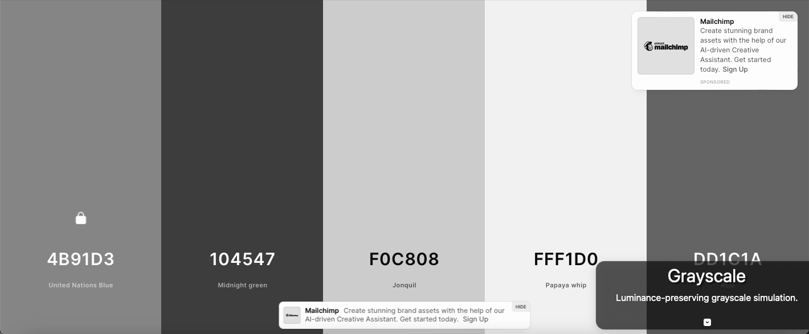
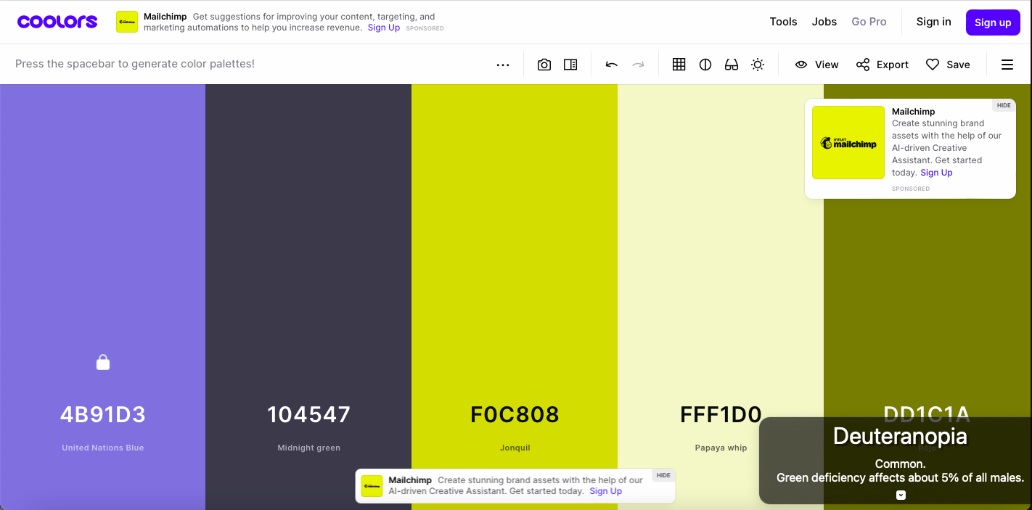
Color continued (3)
In order to compare the Color Oracle views, the middle image is the original view, the top image is in Color Oracle’s greyscale setting, and the bottom image is in Color Oracle’s deuteranopia setting.
Make sure that your colors contrast well in all the settings.

Slide 13
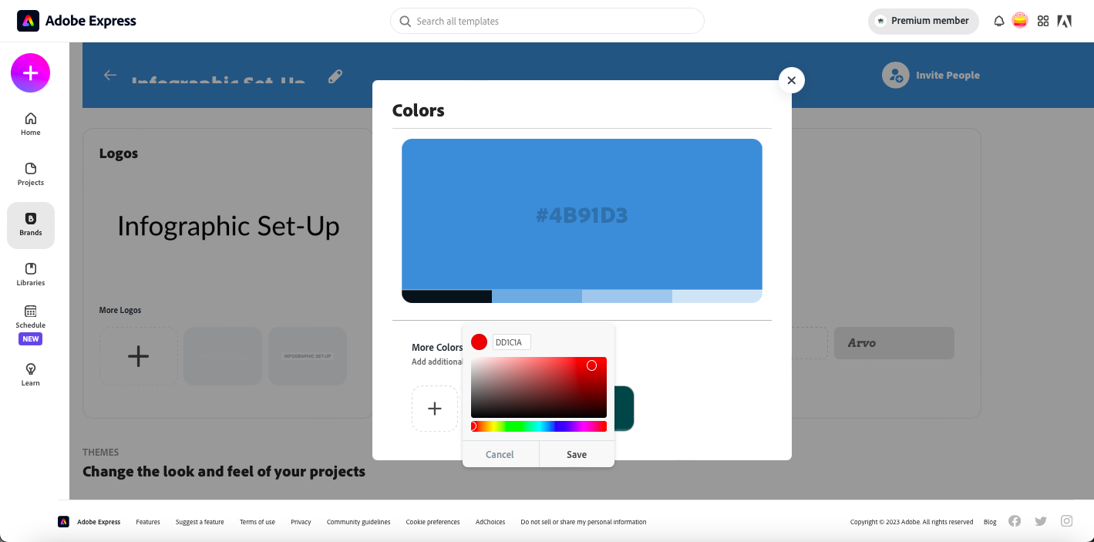
Color continued (4)
In order to upload and save your colors as a palette on Adobe Express, on the Brand page, select the plus icon under More Colors.
Copy each hex code into your brand’s palette.

Slide 14
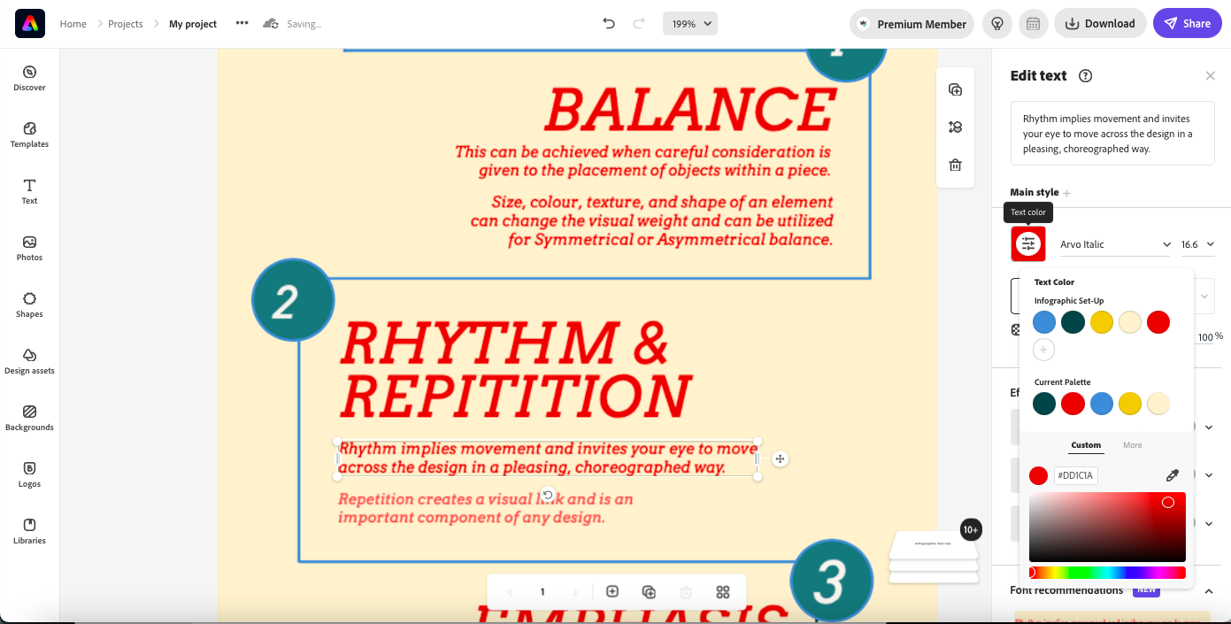
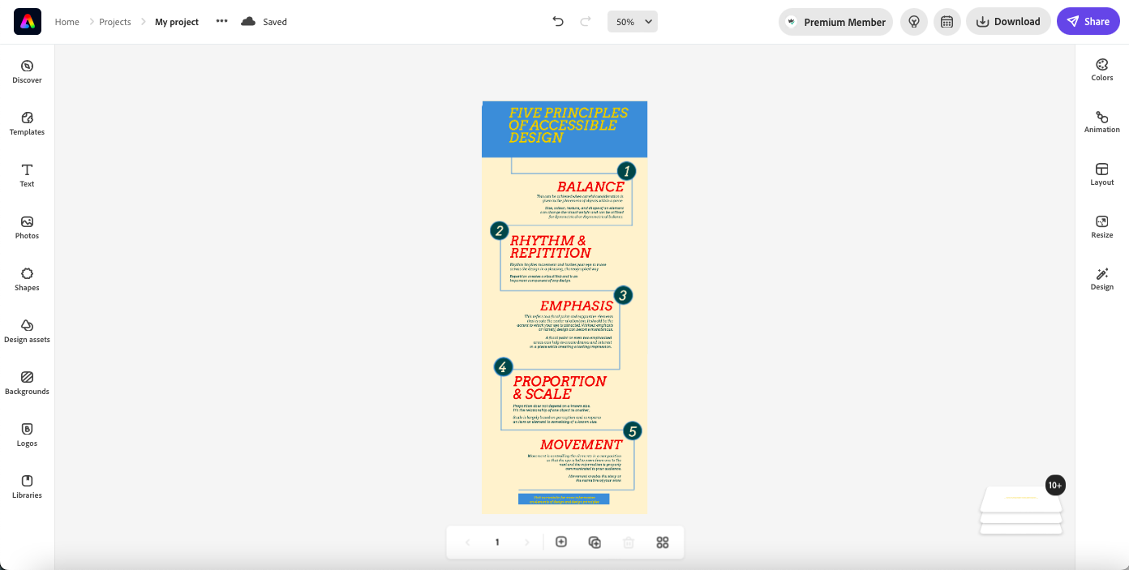
Editing the document
When selecting an element on the design space in Adobe Express, a menu will open on the right-hand side.
The box will allow you to select a color from your brand’s palette.
Ensure consistency throughout your document.

Slide 15
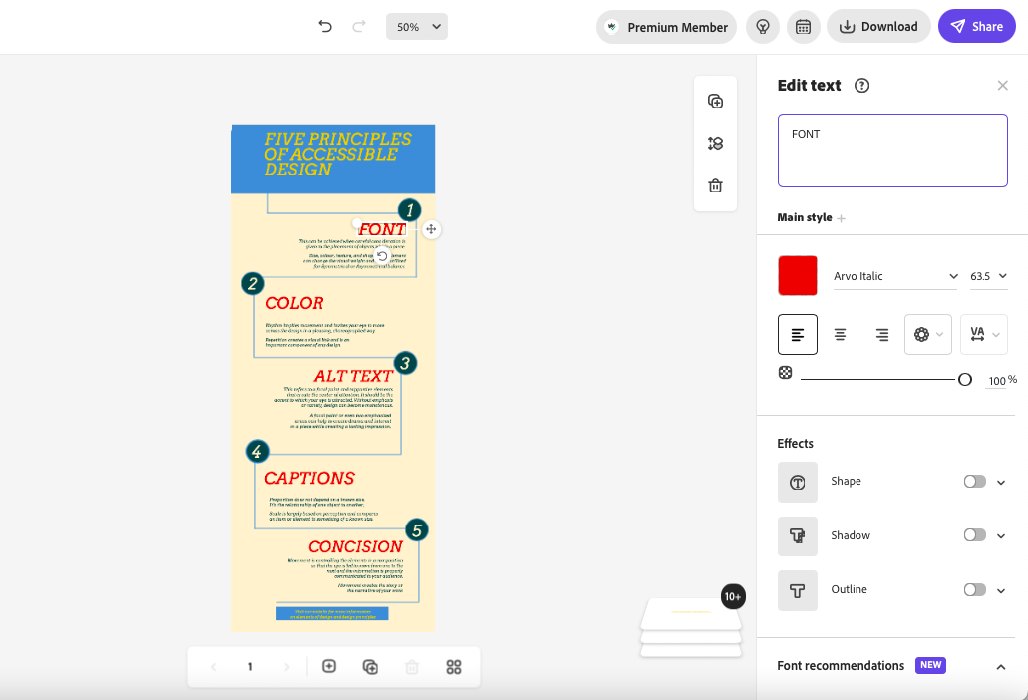
Editing the document continued
The document’s text can be customized similarly to a word processor in Adobe Express.
Customization options include color, font, font size, and alignment.
Don’t forget to utilize the font you selected earlier during Brand creation.

Slide 16
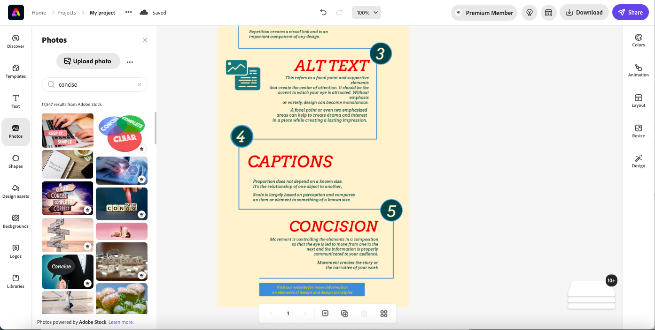
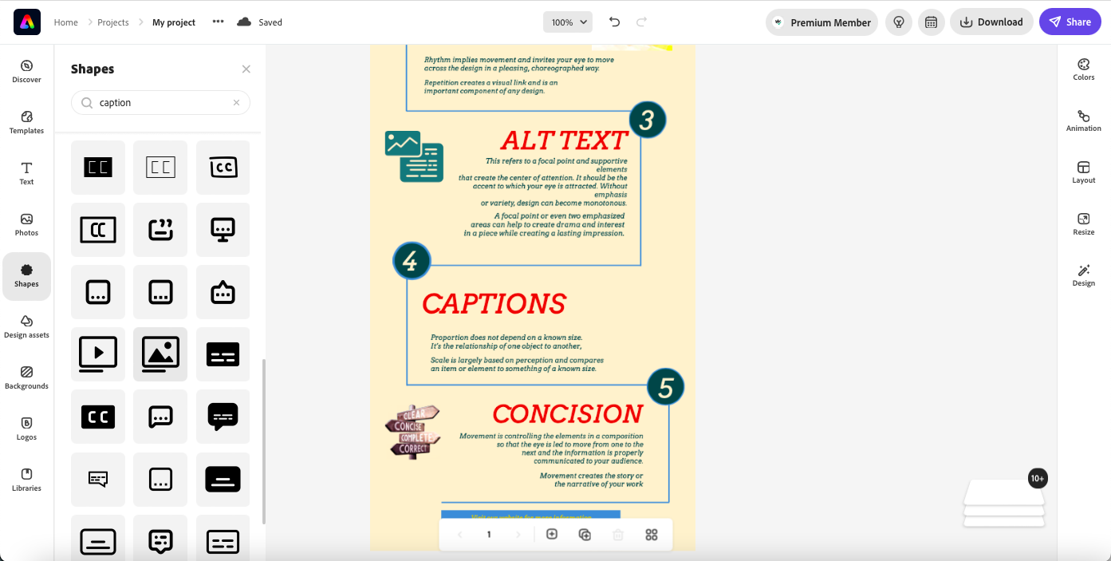
Photos and shapes
Adobe Express provides free-to-use photos and images to include in document designs.
Unfortunately, Adobe Express does not include alt text so that must be a consideration when using these visuals.
All informative images and data visualizations need alt text

Slide 17
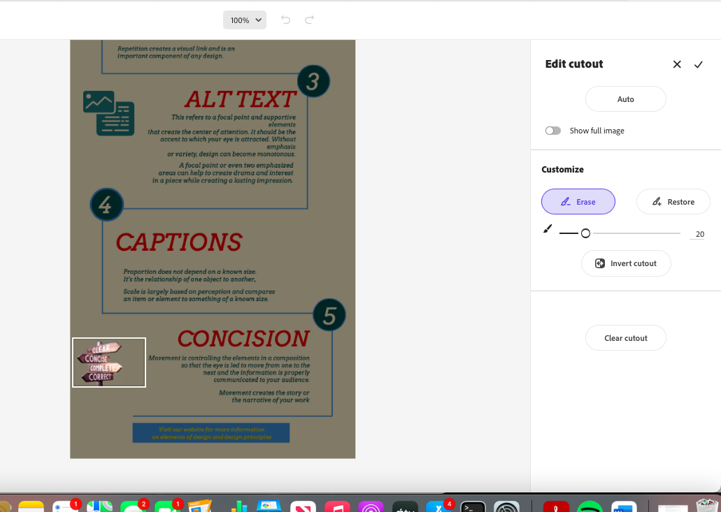
Photos and shapes continued (1)
Once an image is inserted onto a document, Adobe Express can make it a cut-out and remove the background.

Slide 18
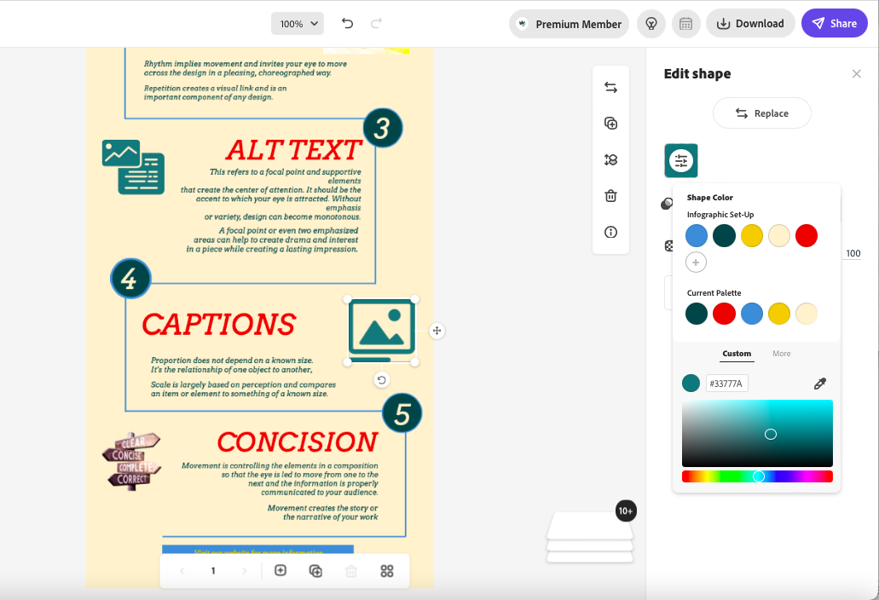
Photos and shapes continued (2)
Shapes can be customized as well.
You can use the brand’s color palette to customize the color of the decorative shape.

Slide 19
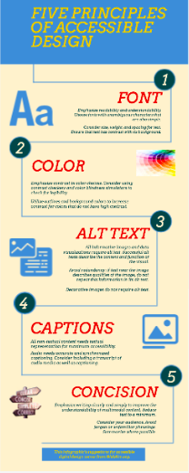
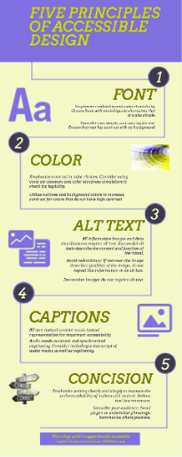
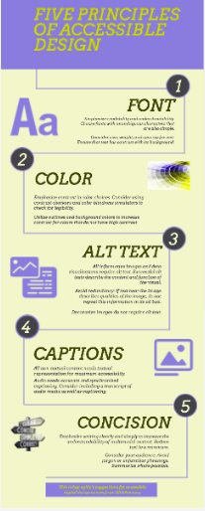
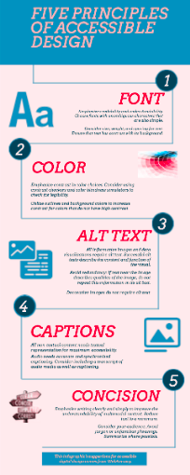
Final Infographics

Slide 20
Conclusions
Design elements can be easily modified or added to for customization and accessibility purposes
Color, font, alt text, captions, and concision are all ways to make your documents more accessible
Tools like Coolors color palette generator, Color Oracle color blindness simulator, Google Fonts font files, and WebAIM’s reference can be used to improve your design and accessibility skills

